Slide 1
Pinellas County Schools Ford NGL Winter Conference

Slide 2
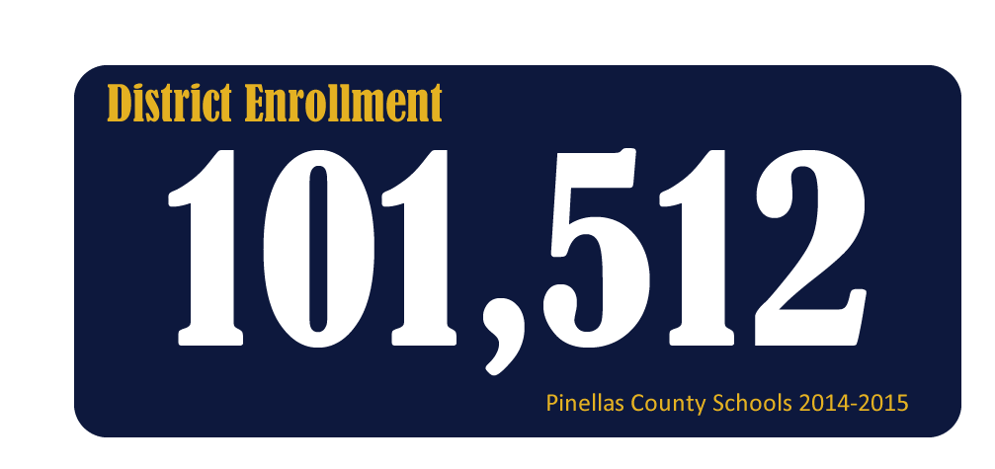
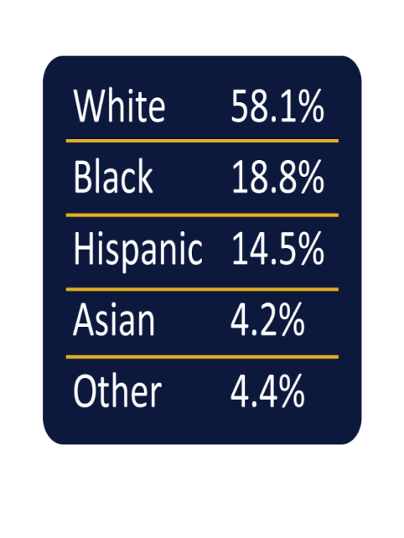
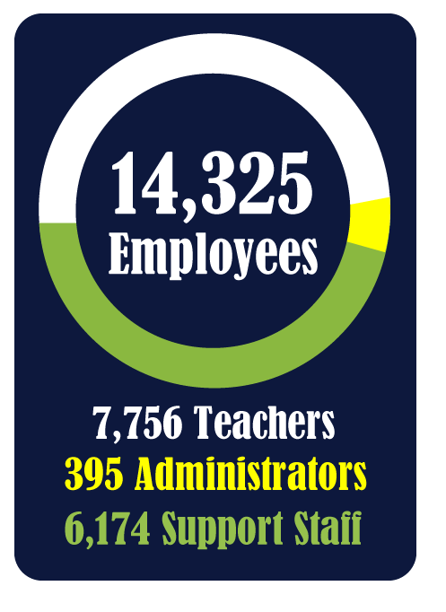

Slide 3
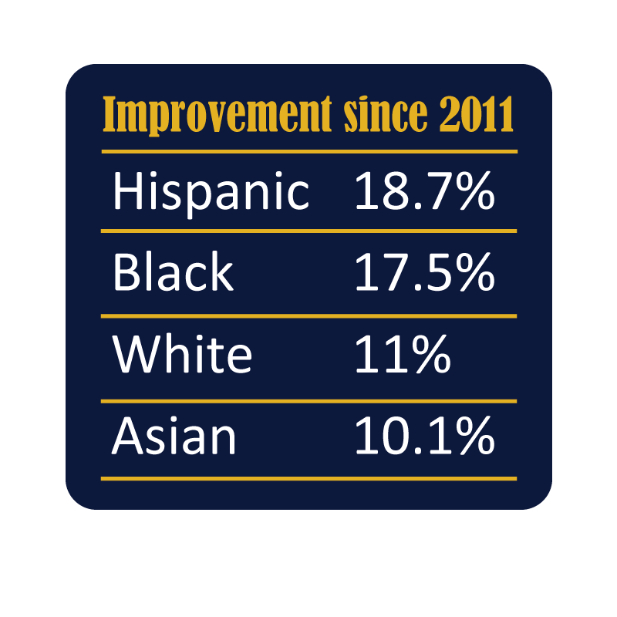
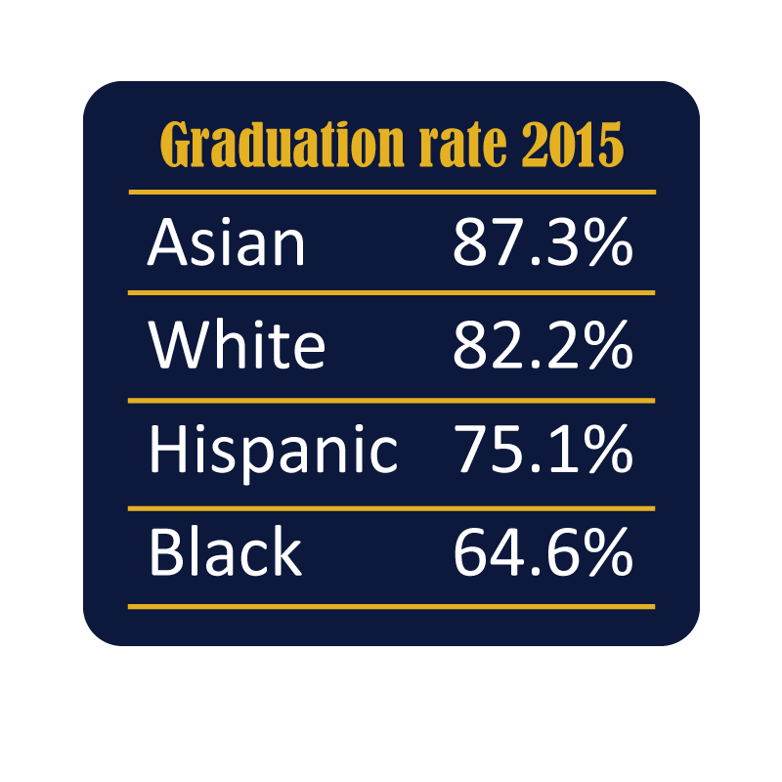

Slide 4
 | 2011-2012 | 2012-2013 | 2013-2014 | 2014-2015
District | 72.0% | 71.9% | 76.2% | 78.3%
State | 74.5% | 75.6% | 76.1% | 77.8%

Slide 5
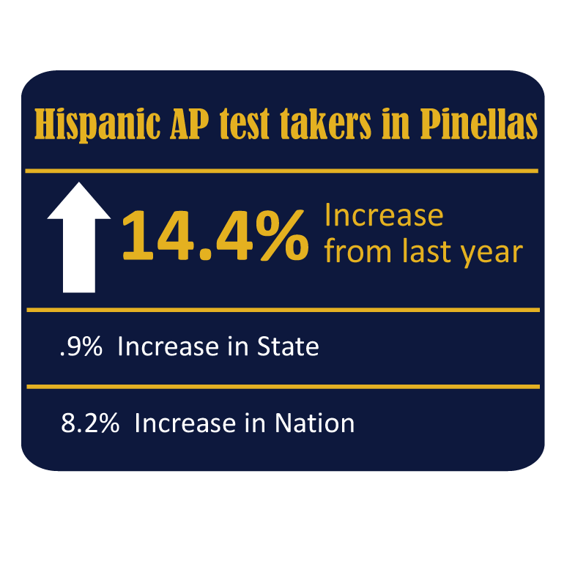
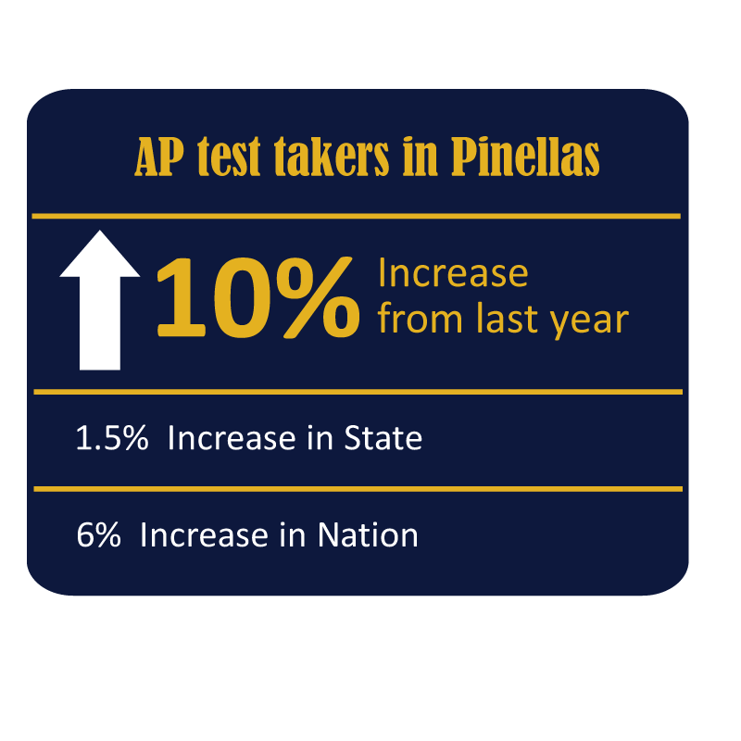
Increases in Number of AP Test Takers

Slide 7
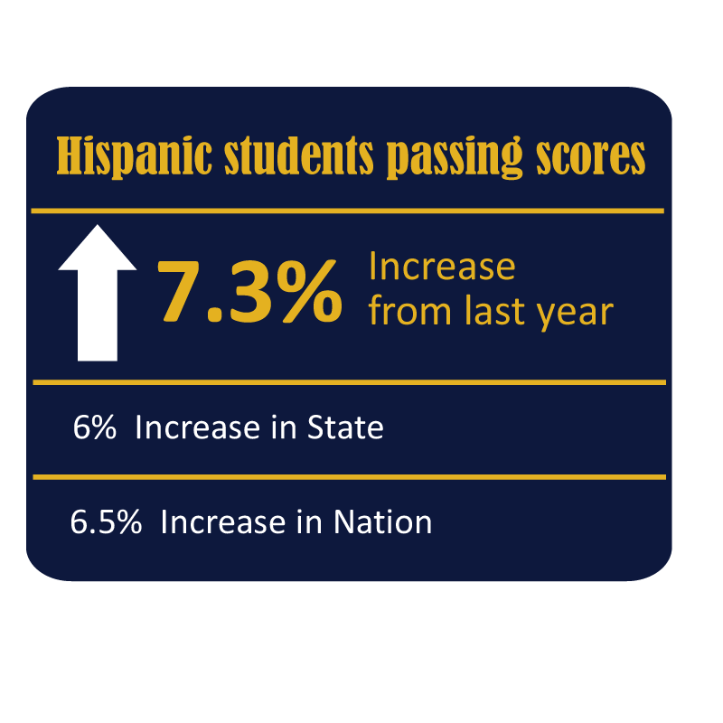
Increases in Number of Black and Hispanic Students Earning Passing Scores

Slide 8
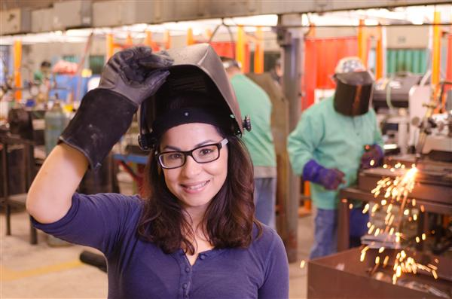
Academy and Career/Technical AP Student Participation
24.7% of all Academy and CTE students also take at least one AP course.

Slide 9
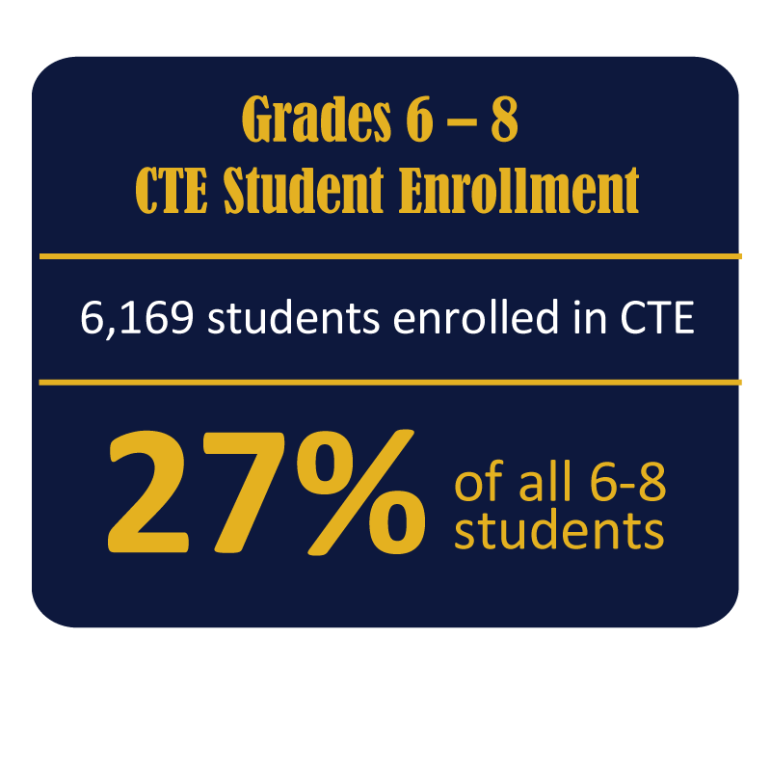
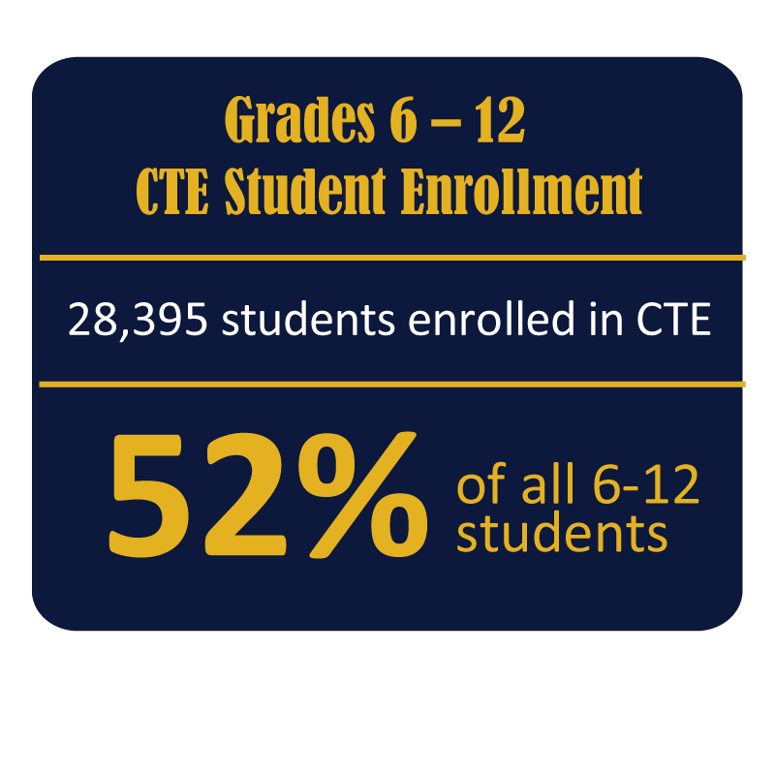
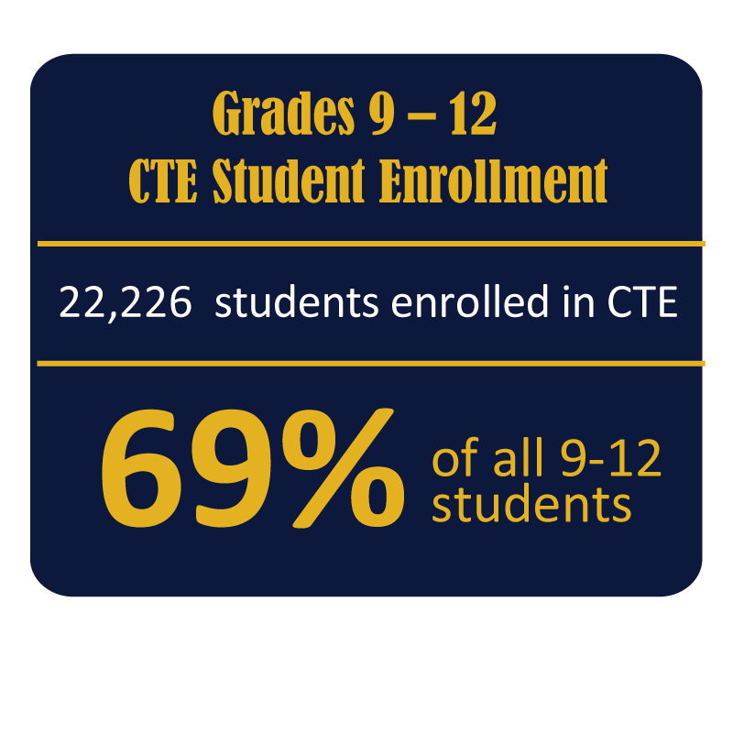
Career/Technical Education

Slide 10
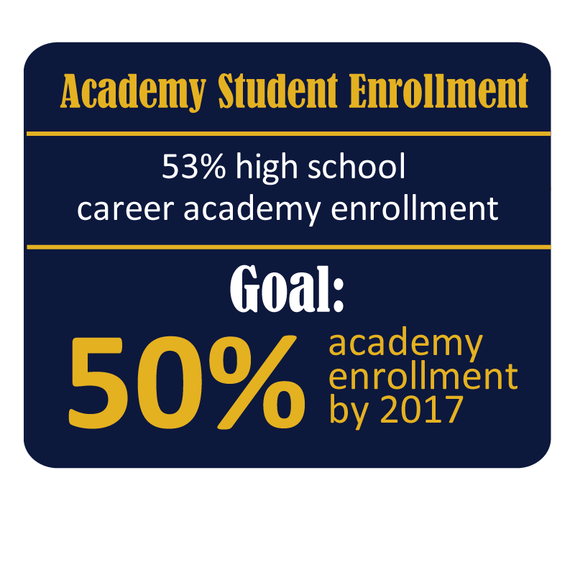
Career Academies

Slide 13
Industry Certifications
2,722
2015-16 to date
Middle School

Slide 14
Fewer Absences
Approximately 68% of CAPE students have 10 or fewer
unexcused absences compared to 54% of Non-Program students.

Slide 15
Higher GPAs

